Slide 1
Online Banking Application
Presented By:
Akshay Kumar

Slide 2
Problem statement
Client wants a Banking software which provides the following functionalities.
Menu Screen - Displaying options
1) Customer - > Perform Customer operations
2) Employee - > Perform Employee operations

Slide 3
Customer operations
Open Account
Deposit Amount
Withdraw Amount
Check Balance
Transaction History
Apply Loan
Money Transfer
Loan Details

Slide 4
Employee operations
Check Customer Details
Check Loan Details

Slide 5
OBJECTIVE
Create Banking Application through which customers and employee can enjoy the banking facilities virtually.

Slide 6







Tech Stack
JAVA
KOTLIN
SPRING BOOT
Maven
POSTMAN
MONGODB
SWAGGER UI
Mockito
SONARQUBE
Docker
Docker Hub
Kubernetes
Selenium
React Hooks

Slide 7
LifeCycle
REACT
APP
Kotlin
APP
Mongo
DB
Docker
Image/ Amazon EC2 Insatance
Selenium
Mockito and SonarQube
Docker Hub
Kubenetes
Deployed on Server

Slide 8
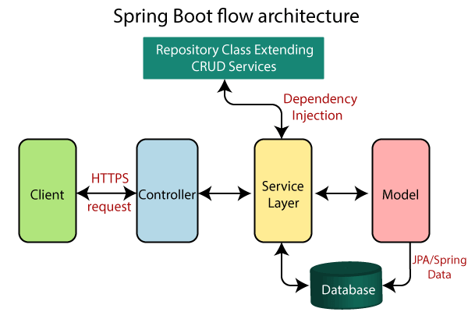
Multilayer architecture

Slide 9
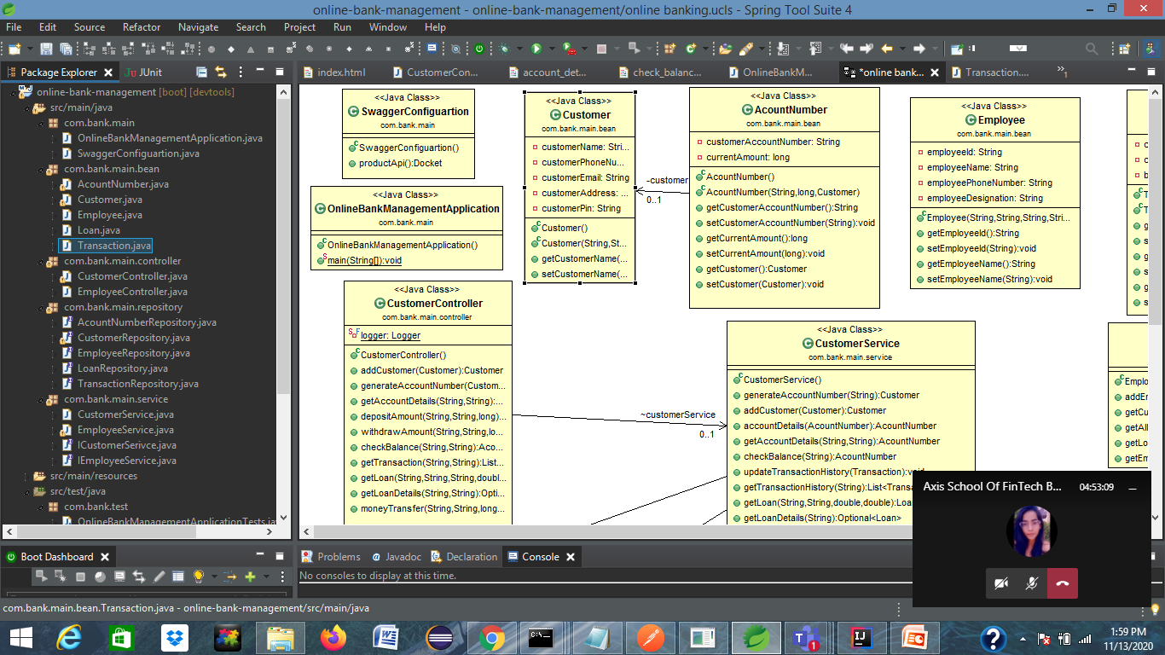
Project structure

Slide 10
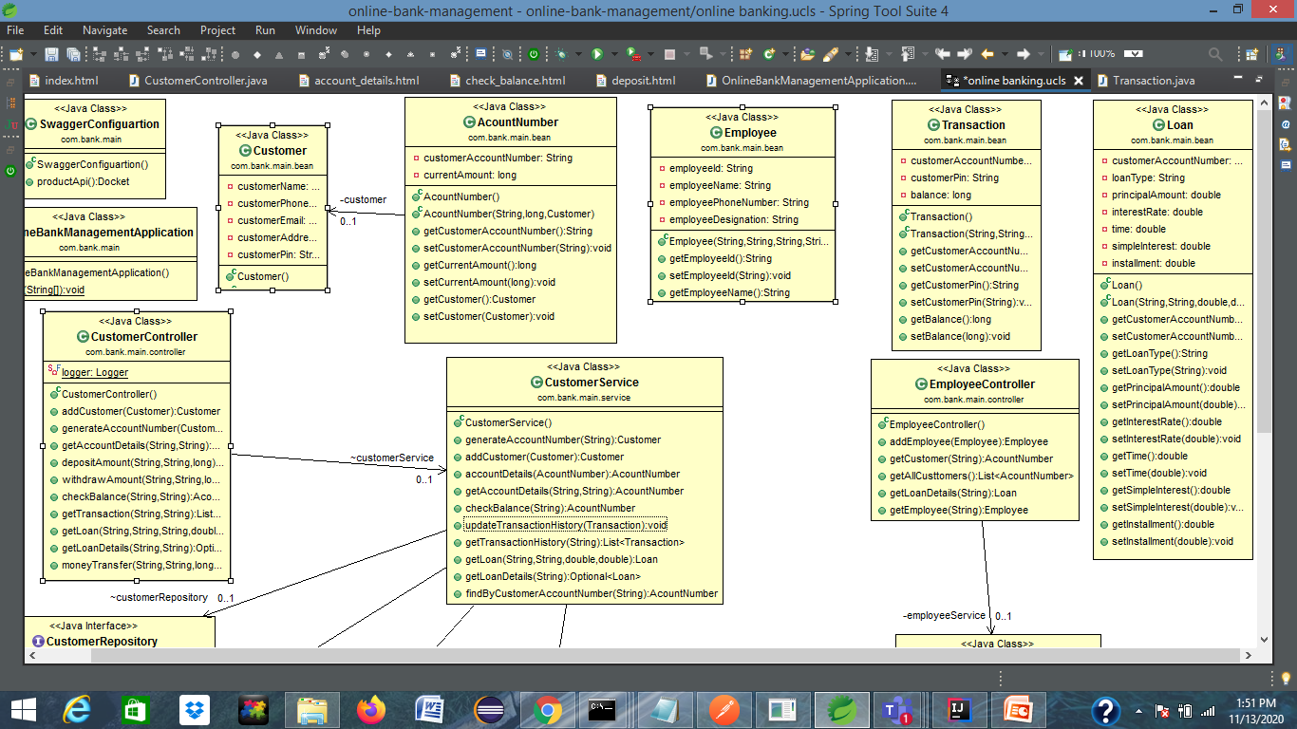
Class diagram

